Slide 1

What should I do if I think my child has a SEND?
How does the school know how well my child is doing?
CLARE COMMUNITY
PRIMARY SCHOOL
SPECIAL NEEDS AND DISABILITY
INFORMATION
How will I be kept informed?
What support is available for a child with SEND at this school?
How are lessons and school facilities made accessible for all children?
Where else can I find support and information?
What agencies does the school work with?
How will my child be supported during school transitions?

Slide 2
How does the school know how well my child is doing?
Day-to-day observations and on-going assessments across the learning areas
Termly and half-termly assessments, Writing and Maths
Pupil Progress Meetings
Data Tracking
Identifying groups and individuals that are not making expected progress
Identifying additional support needed for all children to achieve expected progress and outcomes
Progress of children on intervention programmes is tracked
Outside agencies provide feedback
On-going discussions about observed behaviour linking to possible speech and language, social and emotional difficulties.
Back to the Start

Slide 3
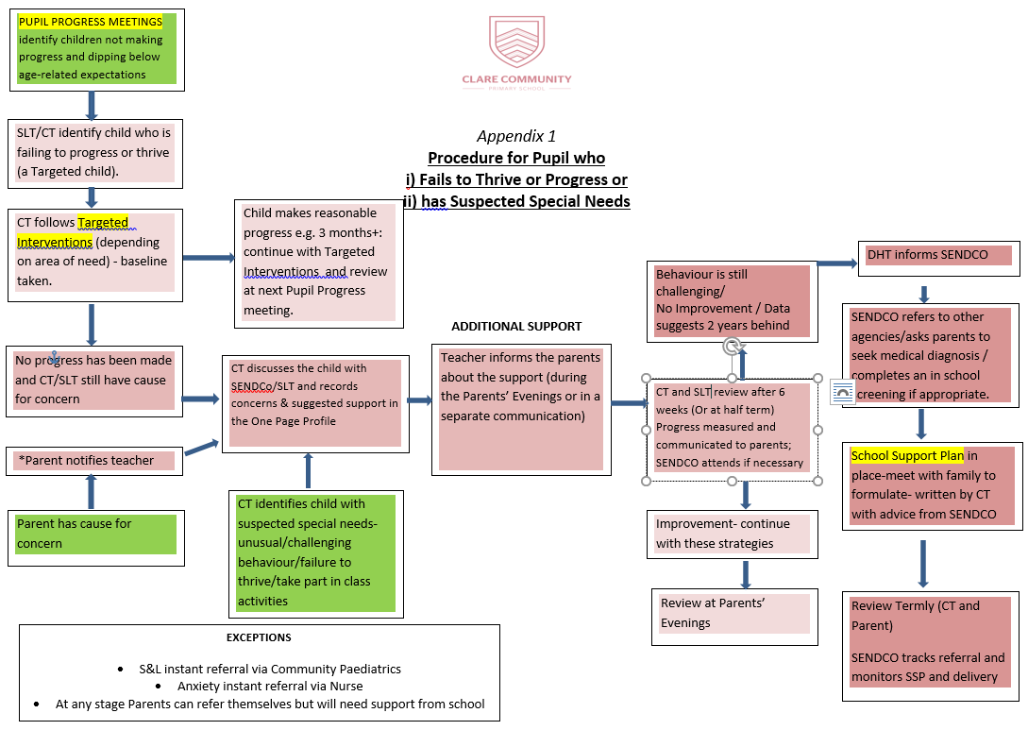
What should I do if I think my child has a SEND?
Follow our SEND Provision Flowchart.
Always talk to your child’s Class Teacher First.
Our SENDCo is Mrs L Brown
Back to the Start

Slide 4
How will I be kept informed?
Informal discussions
Parents Evenings
End of Year reports
School Support Plan review meetings
Education, Health and Care Plan annual reviews for children with EHCP
Reports from external agencies when appropriate
Back to the Start

Slide 5
What support is available for a child with SEND at this school?
Teachers use Quality First Teaching when working with all children.
Teachers use differentiated planning to include and support children of all abilities.
Teaching Assistants support groups or individual children in class
Additional small group or 1:1 interventions when needed (e.g. Speech and Language, Toe by Toe, Literacy Gold, individual reading, etc.)
External agencies provide advice and support to individual children (S&LT, OT, SES)
ICT resources (Accelerated Reader quizzes, Literacy Gold, touch typing online resources)
Staff have appropriate training to support children with specific needs
Back to the Start

Slide 6
How are lessons and school facilities made accessible for all children?
Lessons are differentiated
Teachers are aware of specific needs and disabilities and make reasonable adjustments to ensure accessibility
The building and playground are accessible to wheelchair users.
There are 2 disabled toilets.
Trips are planned taking into account the needs of children with SEND.
Back to the Start

Slide 7
Where else can I find support and information?
Clare Community Primary School SEND Policy
Suffolk Local Offer
Essex Local Offer
The National Autistic Society
Special Educational Needs and Disabilities Information, Advice and Support Service (SENDIASS)
British Dyslexia Association
ADHD Foundation
Suffolk InfoLink | Specialist Education Services (SES) Suffolk County Council
Back to the Start

Slide 8
What agencies does the school work with?
Specialist Education Services (SES)
Educational Psychology
Family Services
School Nurse
Speech and Language Therapy
Occupational Therapy
Back to the Start

Slide 9
How will my child be supported during school transitions?
Reception teacher and SENDCo communicate with the pre-school
Transition days for children within school.
Social stories/transition books are used for transition into a new class.
Staff and Year 7 students from the secondary school visit Clare Primary to speak to the Year 6 pupils transferring to their school.
All pupils in Year 6 are invited to a familiarisation day at their secondary school.
Some children have an additional transition day.
Transition arrangements to Year 7 are planned at Year 6 EHCP reviews.
SEND information is transferred, including school support plans, outside agencies’ repots and record of involvement.
Back to the Start

